Slide 2

Ride for the Brand
Notes:
Facilitator:
If this is the first-time participants are hearing about the Doc B Leadership Academy introduce the Academy. This is a great opportunity to build the “why” behind the “what” of leadership development based on the philosophies and values of Clovis Unified ( script available in resource folder). If this is not the first time briefly review the purpose of the Leadership Academy.

Slide 3
Part II
Notes:
Facilitator:
The purpose of Part II is to go more deeply into the philosophies and values of our district. We examine how to apply the philosophy, generally using local resources and interviews of past and present leaders.

Slide 4
Ride for the Brand
“Son, a man's brand is his own special mark that says this is mine, leave it alone. You hire out to a man, ride for his brand and protect it like it was your own.”
— The poem Ride for the Brand by Red Steagal
Notes:
Script for Levels I,II, and III
Facilitator:
Doc loved western literature. His favorite author was Louis L’Amour. I’m sure you’ve heard that a lot of people thought Clovis was a little “cow town” when Doc first arrived. So, in honor of our founding Superintendent, Floyd B. “Doc” Buchanan and our roots we are going to spend some time on our philosophy ride for the brand” and what that means today. Ask participants to read this portion of the poem Ride for the Brand and think about how it applies to Clovis Unified.
Discussion Points:
Ask for volunteers to share their thoughts. Go to the video on next slide to hear the poem.

Slide 5
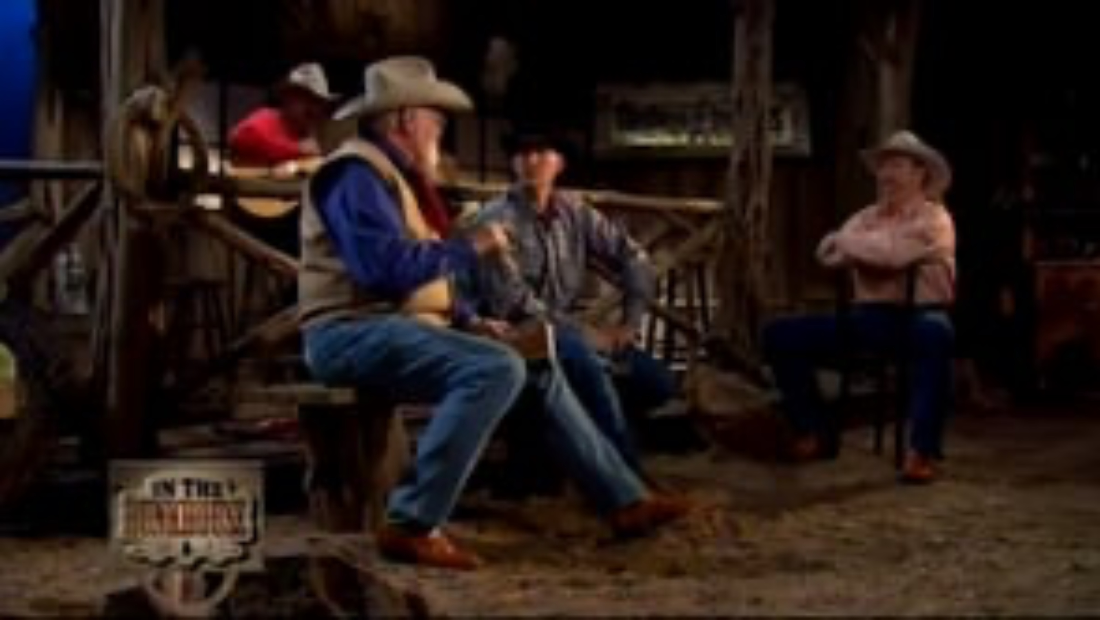
Ride For The Brand by Red Steagal
Notes:
Script: Tier I, II, III
Facilitator:
Russell "Red" Steagall was born in 1938 and is still living and active in the entertainment industry. He is an American actor, musician, poet, and stage performer, who focuses on American Western and country music genres. Steagall is a trustee of the Pro Rodeo Hall of Champions, honorary member of the Cowboy Artists of America, and former board chairman of the Academy of Country Music. I’m sure Doc would have loved this poem : )
Discussion Points:
After listening to the poem
Take 5 minutes to write your interpretation/understanding of Ride for the Brand. You are going to share your interpretation so only write what you want someone else to read.
After 5 minutes ask participants to turn to a neighbor and discuss their interpretations.

Slide 6
CUSD leaders see themselves as part of a larger team.
“We want you on our team”
Doc’s CHARGE
“Each role individuals play in the overall educational experience of CUSD students is important. Each role is critical to the effectiveness of Clovis Unified.”
Historical Overview of CUSD, Educational Roles
Notes:
Script: Tiers I, II, III
Facilitator:
A foundational value is clovis Unified is that leaders see themselves as part of a larger team. We see it in Doc’s Charge and we are going to read about it in the book Historical Overview of Clovis Unified School District which Doc wrote in the late 1980’s. Please read pages 16-18 of Educational Roles (available in resource folder).
In his interview for the Leadership Academy, Dr. Joe Hernandez talks about the strength of CUSD working together to train employees in the value of teamwork, not working in silos and thinking of the collective. Dr. Hernandez is currently the Superintendent of Dinuba Unified School District. He credits his experiences in CUSD as a valuable component of what he has been able to do in Dinuba. I hope it is apparent that everyone who touches a child’s day has a role to play in the overall educational experience of CUSD students and that each role is critical to the success of our students and the effectiveness of CUSD.
Discussion Points:
In small job alike groups ask participants to discuss the following:
101 – In what ways does your school and/or department contribute to the success of CUSD? Provide specific example.
201 – In what ways does your school and/or department operate like a team? Provide specific examples.
301 – Is your school and/or department an effective team? How do you know? Provide specific examples. Discuss ways to improve its effectiveness. Remember, continuous improvement.
After everyone is done ask each group to share one of their examples.

Slide 7
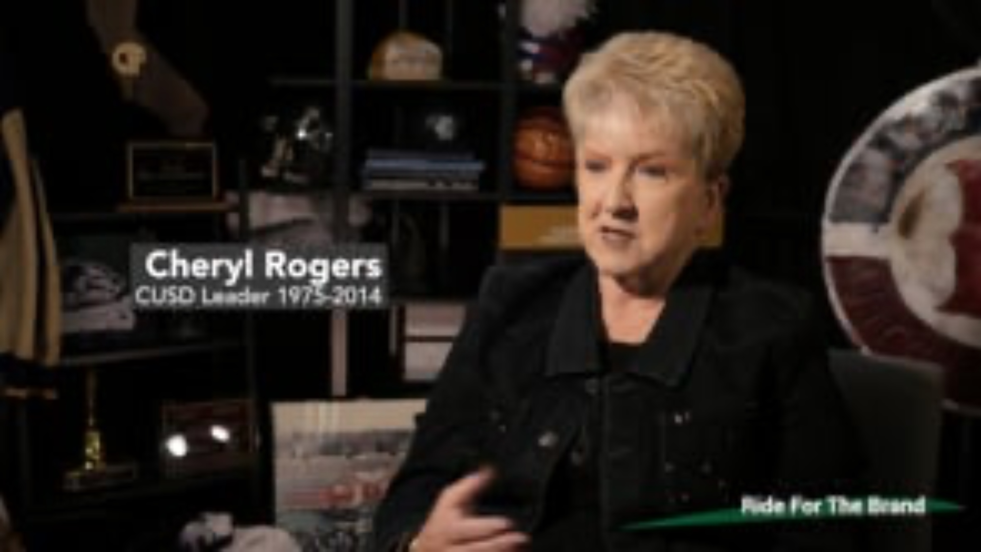
Leaders are willing and eager to fulfill the leadership needs of the District.
1. Are you interested in opening a new school?
2. Do you want to do something different?
3. We need you to do this …
Notes:
Script: Levels I, II, and III
Facilitator:
Dr. Cheryl Rogers talks about how she had to be open to different opportunities as an administrator. There were times she may have initiated a change in her career, but she also discusses a time when she was approached by an administrator to move to a certain position because it was what was needed for the district. Carlo Prandini describes Cheryl as someone who epitomizes loyalty to the district. Dr. Rogers served in many roles during her tenure in Clovis Unified. She began her career as a speech therapist. She served as a part-time program manager for speech teachers at the district level, learning director, principal, Assistant Superintendent and Associate Superintendent for Human Resources.
Discussion Points:
In small job alike groups ask participants to discuss one or more of the following:
101 - What are the difference between questions 1, 2, and 3? Explain your thinking.
201 - Share the positions you have held in CUSD. Discuss which position was your favorite and why? In which position did you learn the most? What did you learn?
301 - Share a time you were asked to do something because it was what the district needed. How did you respond to the request? What did you learn from the experience?
After everyone is done ask each group to share one of their examples.

Slide 8
“There is value in serving through the established leadership pathways of the District.”
Dr. Fugman began as a football coach and teacher.
Steve Weil began as a custodian.
Barry Jaeger began as a Campus Club employee.
Carl Tomlinson began as a walk-on coach.
Dr. Janet Young began as a 1st grade teacher.
Irene Romero-Esquibel began as a financial secretary.
Notes:
Script: Tiers I, II, II
Facilitator:
You see the names of current and former CUSD leaders and their first position in our district on the screen. I began my career in CUSD as (fill in the blank.) I’ve held several/a few different positions. I served as a (fill in some of the positions you have held). Let’s talk about our experiences in Clovis and riding for the brand.
Discussion Points:
In small job alike groups ask participants to discuss the following:
101 –Discuss why it is important for CUSD to have many career path opportunities for employees? What is the value?
201 – Looking at the list of employees and their first jobs in Clovis Unified choose one that resonates with you and explain why.
301 – Share the positions you have held in CUSD. Discuss which position was your favorite and why? In which position did you learn the most?
After everyone is done ask each group to share their responses.

Slide 9
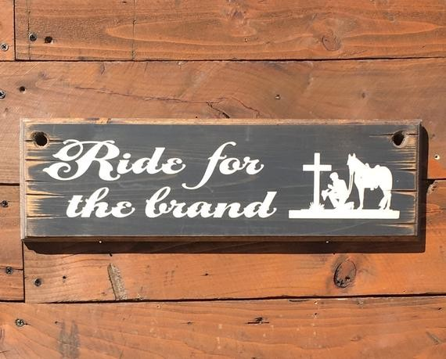
Notes:
Script: Tier I, II, III
Facilitator:
We’ve talked a lot about riding for the brand and working in Clovis Unified. You may hear the comment that this generation of employees do not have the same work ethic or ride for the brand or want to put in the time needed for a successful career. We are going to explore those opinions with the next few slides.

Slide 10

Riding for the Brand
Do we still ride for the brand?
What does that mean?
Does loyalty mean something different than it did years ago?
What happened to “Riding for the Brand?”
Montgomery
Notes:
Script: Tier I, II, III
Facilitator:
We’ve talked a lot about riding for the brand and working in Clovis Unified. On the screen you see our district logo, a representation of our brand. Read the article What happened to “riding for the brand”? (available in resource folder). Think about the three questions on the screen. Be ready to share your opinions with others.
Discussion Points:
In a group of three discuss one or more of the following (facilitator’s choice) the following:
101 – Do CUSD employees still ride for the brand? Provide evidence that illustrates what it means to ride for the brand?
201 – Does riding for the brand mean something different today that it did 60 years ago when CUSD was founded?
301 – Do CUSD leaders demonstrate riding for the brand? Give examples of individuals and their actions.
Ask groups to share their responses.

Slide 11
Riding for the Brand…
When a company seeks to brand itself, it must do so with their values, product and how they want people to feel about it when they interact with it.
What happened to “Riding for the Brand”? Montgomery
Notes:
Script: Tier I, II, III
Facilitator:
Read the statement on the screen from the article What happened to “Riding for the Brand”? Think about the words in bold on the screen. Branding includes values, product, and how people feel about your product and values.
Discussion Points:
In a group of 3 discuss one or more of the following:
101 – When you think of Clovis Unified what are the values that come to mind. Record them on post-its to share with the large group.
201 – When thinking about the CUSD product what comes to your mind. If our product is children what outcomes describe the children.
301 – What measures do we use to determine how people who interact with CUSD and feel about our product. Which of those measures do you feel is most valuable? Why?
Possible answers: SART survey because it deals directly with our parents. Student surveys.
Ask groups to share their responses.

Slide 12
End of Part II
Notes:
Facilitator:
Depending on your time allocation and the audience you have several options.
The PowerPoint is designed for you to use the slides you choose in any order.

Slide 13


